Slide 1







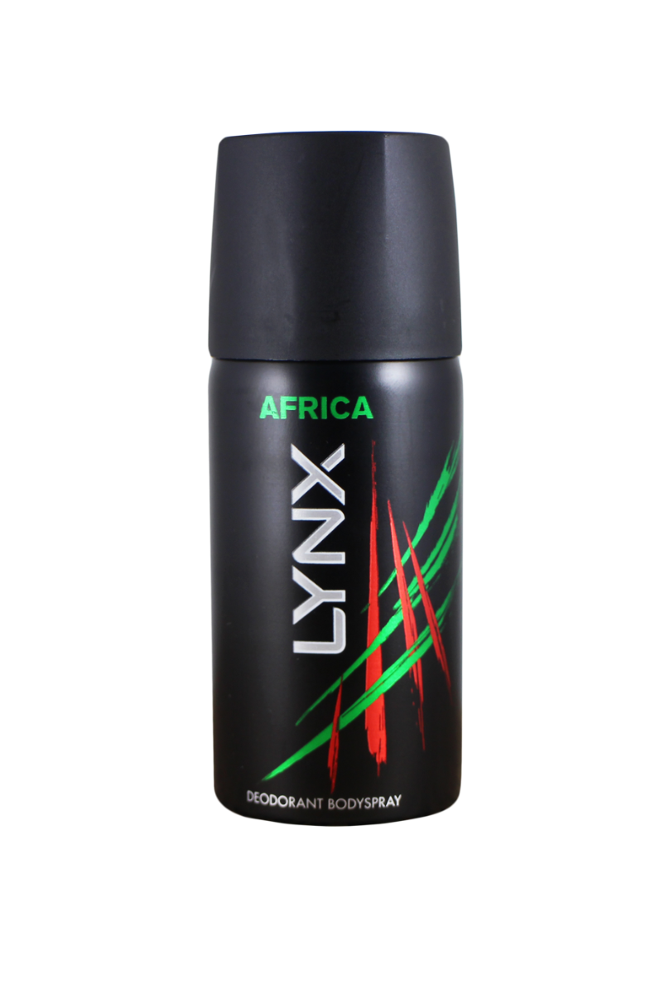





Sprint 8 16th June to 29th June 2021
PM
Martin ‘Maverick’ Fletcher Team Lead
Pawel ‘Viper’ Matyjasek STM
SM
Sam ‘Goose’ Whale Senior Developer
Gregor ‘Iceman’ Janas Scrum Master
David ‘De’ Benedictis Senior Developer
Tim ‘Merlin’ Barton Senior Developer
Payman ‘Cougar’ Labbaf Senior Developer
Mark ‘Jester’ Watts Product Owner
FI
Fatima ‘Charlie’ Imran QA

Slide 2

Sprint goal
Migrate Workstreams components to v3 YAML pipelines
At the end of Sprint 8, the team should have completed the Institution Onboarding stability enhancements carried over from Sprint 7, and converted Workstreams releases to the new v3 YAML pipelines
to meet Auditing findings.
An investigation into the recent Auditing stability and data storage issues will have also been completed, and an action plan created to resolve these issues to prevent further incidents.
The stretch goal is to continue the development of the new Collective Approvals system, implementing the Users Projection component.
Notes:
The second point on the Users Institution search story prevented us from employing some less favorable long-term approaches.
Blob storage - An institution onboarding has failed in SIM with a potential root cause being the failure to write image assets to the private storage account (which was a temporary dual write whilst data was being migrated to the new public storage account).

Slide 3
What value did we deliver? (Sprint 7 Spill)
Institution Onboarding - Replace null or whitespace PO numbers with a default value to stop rollbacks Currently, the Billing API returns validation error if PO number is null or whitespace despite PO number being optional, This enables better operations resiliency when onboarding customers and removes the need to users to enter N/A in optional fields.
Users Institution - Enhanced Institution Principal Search Endpoint Extended the accepted parameters to allow searching by email (full or partial), and to also optionally include deleted institution principals in the search. This is an enabler for the email address validation improvements for institution onboarding, but also allows for a richer searching capabilities for future integrations.
Institution Onboarding – Email Address Validation The institution onboarding process currently causes rollbacks when invalid or duplicate user emails have been provided. Enhancements made to the validation of user email addresses in the institution onboarding process, to perform validation up-front, and to prevent rollbacks occurring.
Notes:
The second point on the Users Institution search story prevented us from employing some less favorable long-term approaches.
Blob storage - An institution onboarding has failed in SIM with a potential root cause being the failure to write image assets to the private storage account (which was a temporary dual write whilst data was being migrated to the new public storage account).

Slide 4
What value did we deliver?
Workstreams - Convert SF Release to V3 YAML Pipeline This was completed and released to Sim but was an iterative process with a slow feedback loop. This had a problem in the Sim release and has required a new release to be developed. This is ongoing. As part of this process, we updated and contributed to the migration scripts and V3 updating process making easier for future teams to complete.
Notes:
The second point on the Users Institution search story prevented us from employing some less favorable long-term approaches.
Blob storage - An institution onboarding has failed in SIM with a potential root cause being the failure to write image assets to the private storage account (which was a temporary dual write whilst data was being migrated to the new public storage account).

Slide 5
What value did we deliver?
Non sprint work
There were two incidents of production dead letters caused by ongoing Elastic Search issues.
Only one incident of dead letters caused by missing correlation ids

Slide 6
What value did we deliver?
Expedited Items
3 expedited tickets to respond to dead letters
Notes:
An institution onboarding in SIM has failed, and did not trigger a rollback and has left partial data for an institution.
We need to compile the required identifiers for data created by the failed onboarding so that a rollback can be processed for the institution.

Slide 7
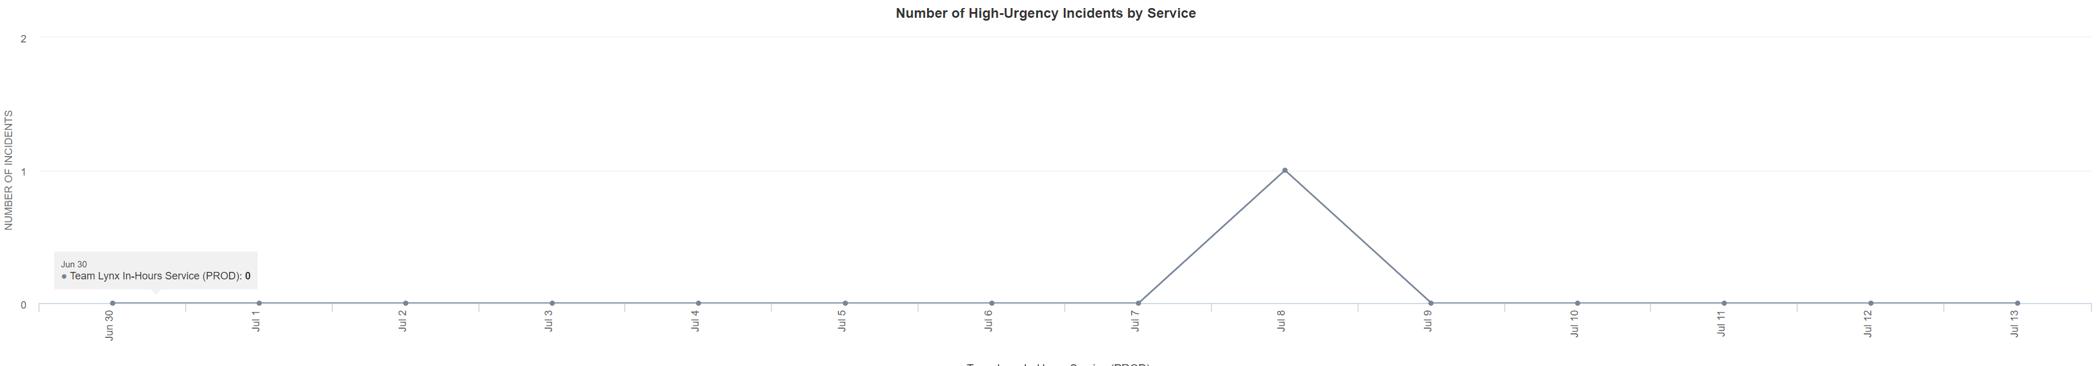
PagerDuty Incidents
Notes:
Solved root cause of prod alerts
No alerts since middle of sprint

Slide 8
Lessons learned
The dead letter incidents raised against other teams has had a profound effect on the number of alerts triggered.
The V3 templates and migration process was not as complete as it was promised.
There are many non idempotent message handlers in the ClearBank code base.

Slide 9

TEAM HEALTH
Team Statement
‘Context switching and changing priorities are a drain on morale’
Team Health Score
6/10
Manual Workarounds - 1
Unexpected Corrections - 0
Incidents – 2
Expedited Items – 3
PagerDuty Prod Alerts – 2
PagerDuty Staging Alerts – 1

Slide 10
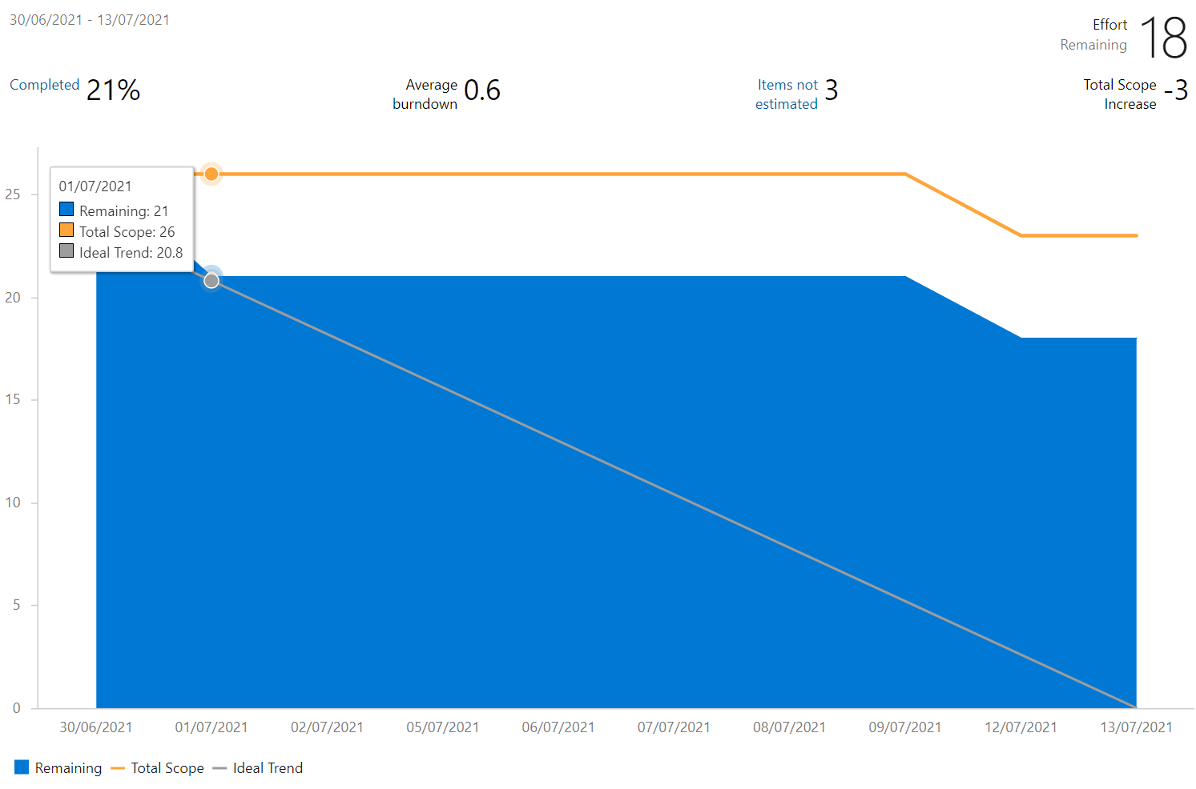
Sprint Burndown

Slide 11

WHAT’S NEXT?
By the end of Sprint 9
Finally validate users email addresses during onboarding to prevent incidents
Have a solution for repair the auditing dead letters in Sim and Prod
Upgrade Workstreams database to V3 templates
Upgrade Collective Approvals API to V3 templates

Slide 12













Platform Roadmap
New approvals administration screen (microsite)
TBC
TBC
Test collective approvals with API Token Permission features
Migration of Inbound/Outbound Service Fabric Remoting to REST Endpoints
(Q1 2022)
Design API contracts and Events for new Collective Approvals
TBC
TBC
Initial deployment of Collective Approvals components

Slide 13

Questions

